Slide 1
Law and AI

Slide 2
ACKnowledgements
Thanks to Owl from the Laion server for introducing me to this topic

Slide 3
Agenda
Introduction/Why Law is Hard
Logical Framework for Law
Can we speed it up?
Data Issues
Current LLM solutions

Slide 4

Why is Law hard? 3 fundamental issues

Slide 5
Court Structure
Approach 1:
Why can’t we replace
Judges with computers?
Judges
Prosecution
Lawyers

Slide 6
Can’t we just “prove” guilt?
We have
Evidence
Arguments for why the defendant is Guilty
Arguments for why the defendant is innocent
-> Compute?

Slide 7
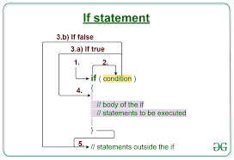
Bit more formally
Can’t we have a series of If statements to conclude Guilt?
Image from https://www.geeksforgeeks.org/java-if-statement-with-examples/

Slide 8

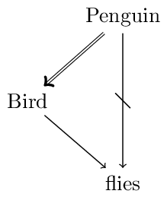
Yes but… This is not typical logic
Tweety Bird
Images from https://en.wikipedia.org/wiki/Tweety and https://plato.stanford.edu/entries/logic-nonmonotonic/

Slide 9
Nonmonotonic Logic
New facts/arguments can completely change the conclusion
In our series of If statements one argument can cause us to recompute from start!!

Slide 10
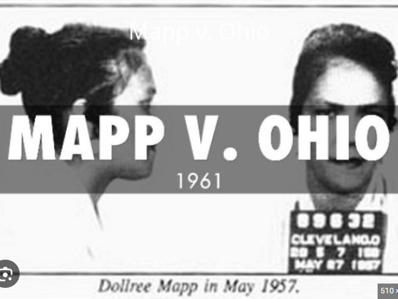
Real-life example: Mapp V Ohio
Historically, very important US case that made illegal police searches without warrants illegal
Image from https://www.storyjumper.com/book/read/92718926/Mapp-v-Ohio

Slide 11
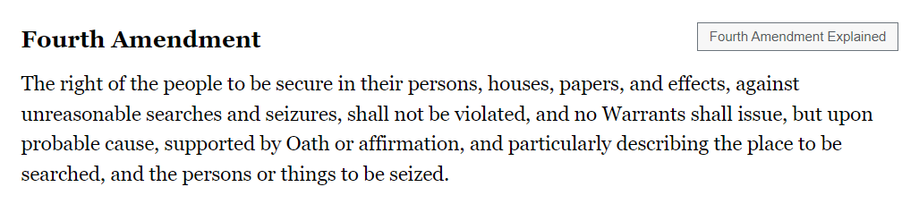
From https://constitution.congress.gov/constitution/amendment-4/

Slide 12
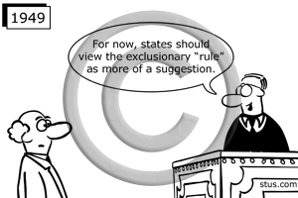
Why? On the state level more than ½ of the states were against excluding evidence gotten without warrant
From https://stus.com/Wolf-v-Colorado-cartoon-cpr0036

Slide 13
Why? More than 2/3 of the states support exclusion rule now!
From https://stus.com/Wolf-v-Colorado-cartoon-cpr0036

Slide 14
Some points
Laws can change between arguments so the “premise” can be different between each case
Judges can reach different conclusions on the same case
Here, I’d like to point out the first fundamental issue with law and AI

Slide 15
The first fundamental reason why law is hard(Thanks singh)
Law is perhaps purposely ambiguous and open to interpretation
Coding law into programs will bring intrepertations per each law and will need to constantly be revised!(Like in Mapp V Ohio)
So, while people can have an idea of what the coded law is currently, they will have no idea after each case and each new legislation

Slide 16
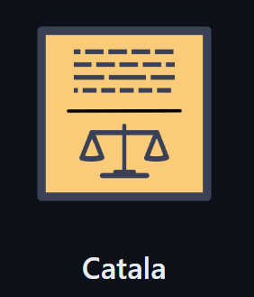
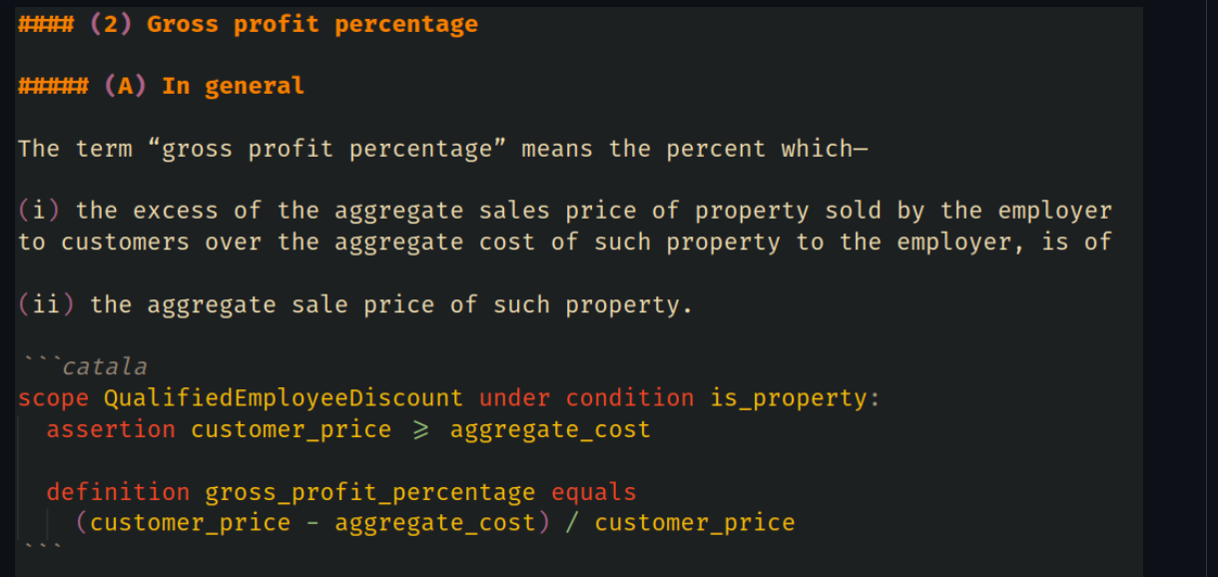
Open initiatives

Slide 17

What is the modern state of resolving arguments?​

Slide 18
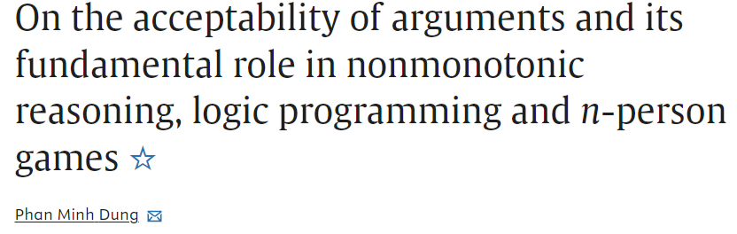
First paper that introduced resolving arguments
Begins with Question: How can we “accept” arguments?

Slide 19

Foundation-basic argument
I: “I cannot negotiate with A because they don’t even recognize I”=i1
A: “I doesn’t recognize A either”=a1
I: “But A is a terrorist organization”=i2
Who won this argument?
From https://t1.gstatic.com/licensed-image?q=tbn:ANd9GcRYiBmKxBJwPlmTL99Tb3rUBVfLOOixY_9y28HL-QO4C08p1FU2lTkUm6mnBVeTGwgn

Slide 20
With circles and arrows
i1
1. i1 and a1 attack each other
2. i2 attacks a1
3. i2 defends i1
The one with the last word wins
a1
i2

Slide 21

In this world what argument is acceptable?
An Argument is accepted if it can defend against all counter arguments
= it can attack all counter arguments.
Main argument
Counter arguments

Slide 22
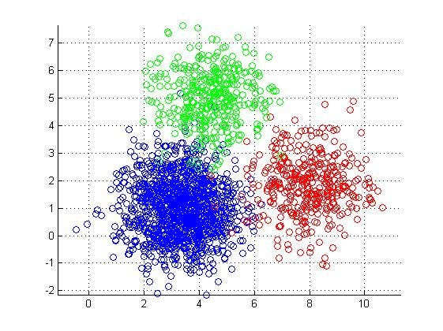
Can we cluster arguments?
From https://www.kdnuggets.com/2019/09/hierarchical-clustering.html

Slide 23
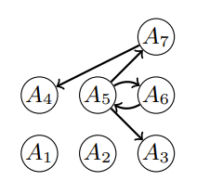
Yes! For example
We can get clusters
Always true = (A1, A2)
One argument = (A1, A2, A5, A4)
Other side=(A1,A2, A3, A6, A7)
This is called Complete Extension
Every argument that is acceptable in
The set belongs to the set
From https://proceedings.kr.org/2020/63/

Slide 24
The Second fundamental reason why law is hard(Thanks singh)
In above, we get clusters with their conclusions but how do we say which is right?
The only method is for us to form a new argument to attack some clusters until there is only one cluster with one “conclusion”
So, overall, even in the best-case scenario, we still need judges

Slide 25
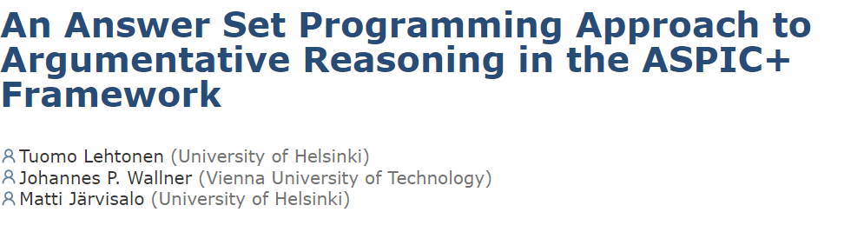
Now, what’s the computational Complexity?

Slide 26

We can map our argument framework to answer set programming!
Which means we can make a program out of it!

Slide 27
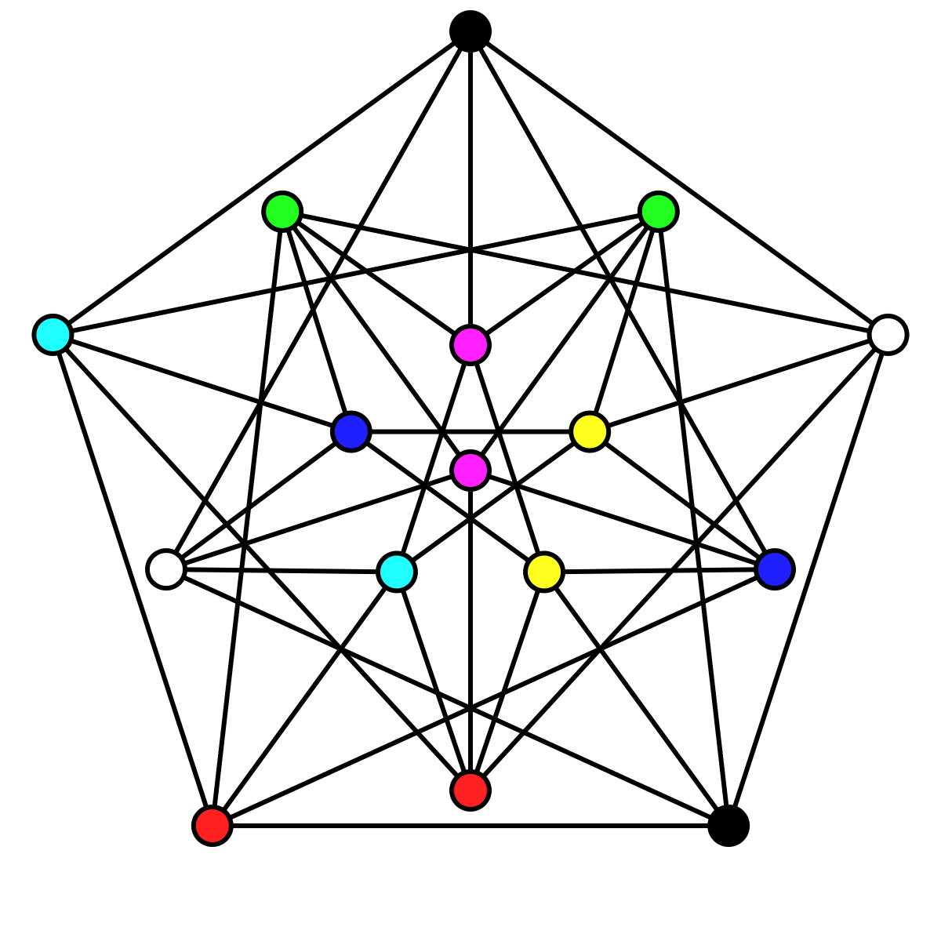
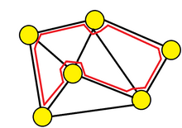
Other ASP Problems
Graph Coloring
Hamiltonian Cycle
These are very hard computer science programs in set of problems that are NP-Complete.
How about arguments?

Slide 28
The Third fundamental reason why law is hard
Also, NP Complete
Every new argument can completely destroy previous arguments.
We might need to recompute from scratch every time!
Main argument
Counter arguments

Slide 29
Can We speed this up?

Slide 30
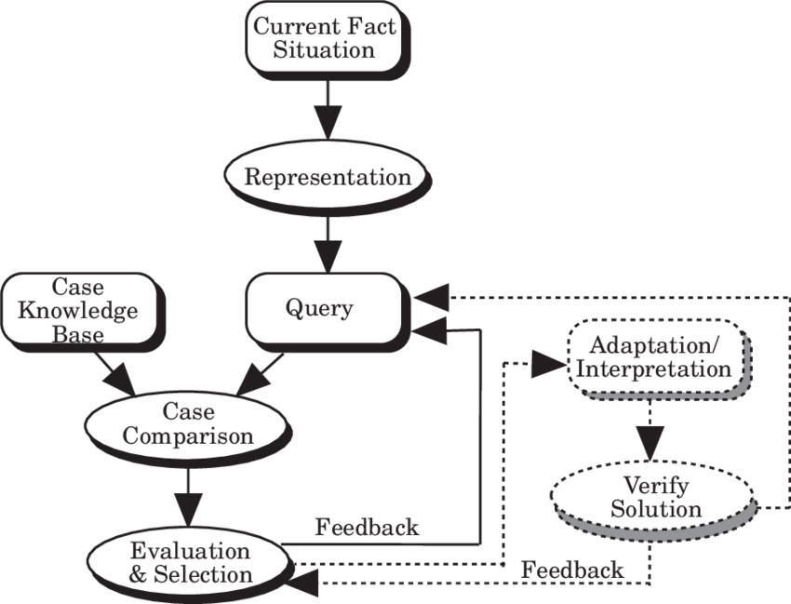
HYPO-The “first” law AI in 1987
Issues:
1. Representation may not be correct
2. Assumes past case results are always true
-> Mainly just for trade secrets

Slide 31
Can we add some arguments without making it exponential?
“Induction of Defeasible Logic Theories in the Legal Domain”
Given evidence, choose “greedily” best arguments to get to conclusion(given a dataset)
There is a trade off between how true our conclusion is and performance
Human judges do not get the “true” answer but an approximation over “main” arguments. Ex, precendences

Slide 32
Data issues

Slide 33
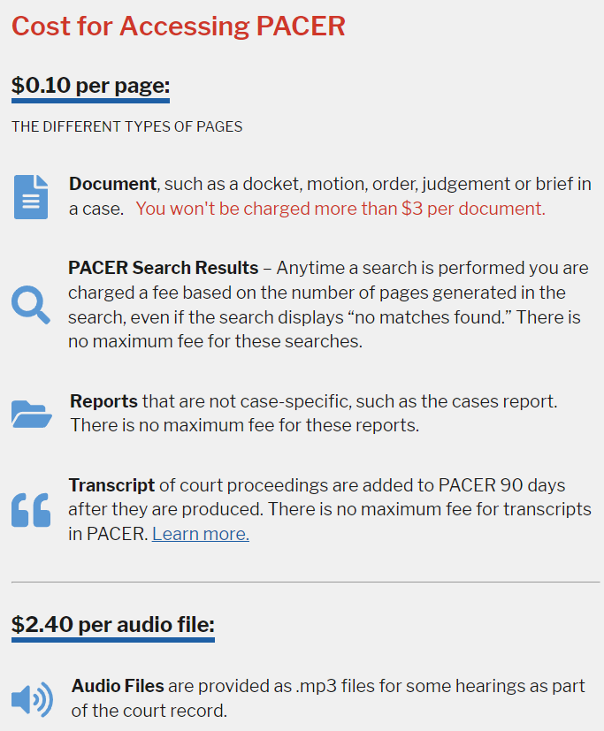

PACER-Can be A US issue

Slide 34
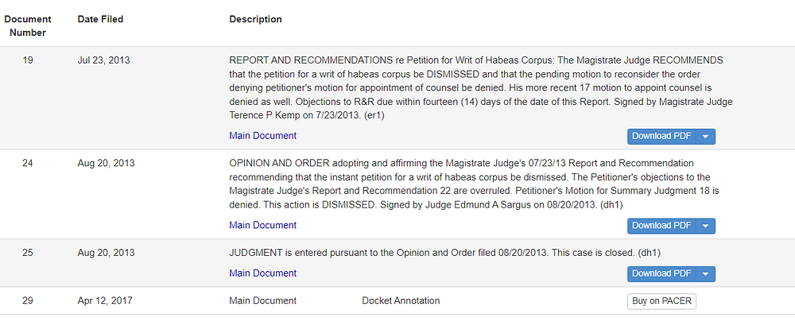
Court Listener-NON profit
Data in legal domain, most likely has the main document/arguments is behind paywalls

Slide 35
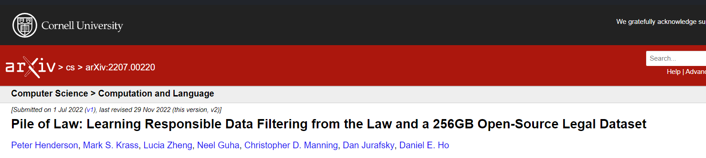
Largest Open Source Law dataset

Slide 36
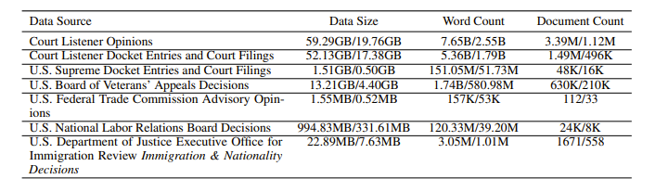
Data sources
Legal Case Opinions and Filings <= Court Listener is the biggest part of the dataset
Legal analysis
Laws
Contracts
Conversation
Study Materials

Slide 37
Issues
Same issue as Court Listener. Very few “main” documents
We don’t know the current law/precedence at the point of each texts. Current rulings can be wrong now but correct in the past

Slide 38
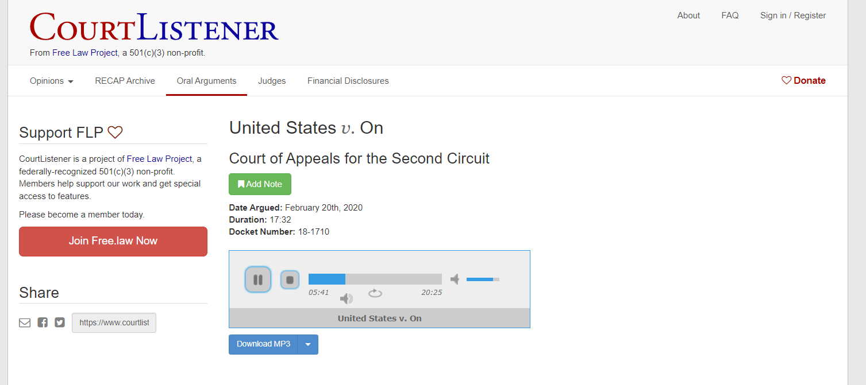
Low hanging fruit: Oral Arguments

Slide 39
Current LLM approaches

Slide 40

China is moving towards automating justice
“promoted easier access to justice, enabled faster dispute resolution, saved costs by moving the judicial process online and ensured that judgments can be enforced.”

Slide 41
LLMs for law from China
LawGPT_zh
LexiLaw
Lawyer LLaMA
HanFei
ChatLaw
Lychee
WisdomInterrogatory
JurisLMs
Fuzi.mingcha

Slide 42
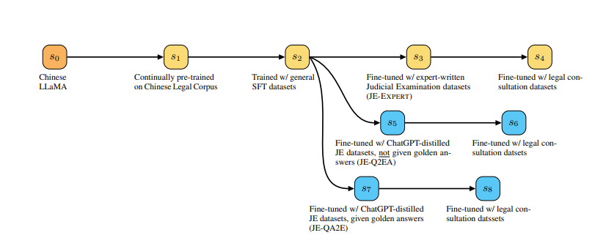
General approaches: Lawyer LLaMA
lawyer-llama

Slide 43
Typical combo
Pretrain
Make an instruct/Use an instruct dataset in that domain for Supervised fine-tuning
While it might work not specific to law.

Slide 44

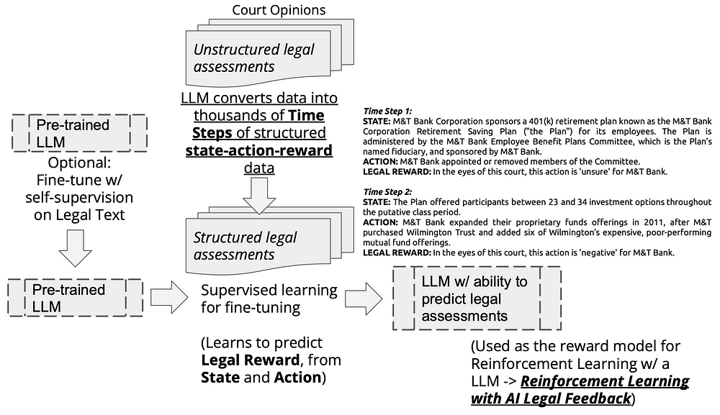
Interesting AI: Carper AI

Slide 45
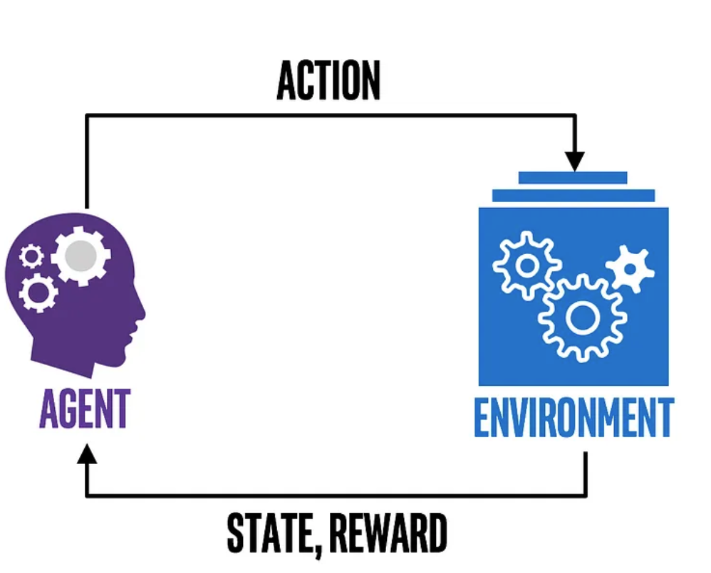
Have LLM learn to predict how well the current action given “state” is(Judge)
Given this state, train the next LLM to find “action” to maximize reward!(Lawyers/Prosecutors)
From https://medium.com/ai%C2%B3-theory-practice-business/reinforcement-learning-part-1-a-brief-introduction-a53a849771cf

Slide 46
Issues
Non-monotonic logic frameworks like ASP not used and also same data issues:
Same issue as Court Listener. Very few “main” documents
We don’t know the current law/precedence at the point of each texts. Current rulings can be wrong now but correct in the past

Slide 47

Conclusion

Slide 48
Currently, the main challenges of Law in AI seem to be
At least in the US, the prohibitory access to court cases in data
The computational complexity of the argument framework for argumentation is NP-Complete
Lack of consideration of laws changing with time.
Lack of connection between logic frameworks and LLMs

Slide 49
THANK YOU

Slide 50
Papers
On the acceptability of arguments and its fundamental role in nonmonotonic reasoning, logic programming and n-person games
An Answer Set Programming Approach to Argumentative Reasoning in the ASPIC+ Framework
Induction of Defeasible Logic Theories in the Legal Domain
Pile of Law: Learning Responsible Data Filtering from the Law and a 256GB Open-Source Legal Dataset
The Smart Court - A New Pathway to Justice in China?
Large Language Models in Law: A Survey

